Slide 1
EFFECTS OF ALCOHOL CONSUMPTION ON ACADEMIC PERFORMANCE
A Study of Stellenbosch University Students

Slide 2
GROUP 6 (ADVANCED DATA ANALYTICS)
Emmanuel Orieh
Emmanuel W. Annor
Enoch Wobenu
Eric Darko Akonnor
Esther Obeng
Etornam Klu Yao
Eyram Alifo
Fatimatu Yakubu
Bansah Promise
Mohammed Kasim
Marvellous Tei
Naomi Darpoh
Enoch Owusu

Slide 3
Overview
The project aims to investigate how alcohol consumption affects the academic performance of students in Stellenbosch University. By examining various variables related to alcohol consumption and academic metrics, the study seeks to identify any correlations or patterns that may indicate the impact of alcohol on students' grades and overall academic success.

Slide 4
Data Description
The data used for the project was sourced from Kaggle, and the survey taken in 2024.
Brief descriptions of columns in data set:
Timestamp: The date and time when the survey response was submitted.
Sex: The gender of the respondent (e.g., Male, Female).
Matric (grade 12) Average/ GPA (in %): The student's average grade or GPA in percentage from their final year of high school (Grade 12 or Matric).
Level last year (2023): The academic year (or level) the student was in during 2023 (e.g., 1st Year, 2nd Year).
Faculty: The faculty or department the student belongs to (e.g., Arts & Social Sciences, Economic & Management Sciences, Engineering).
Your 2023 academic year average/GPA (%): The student's average grade or GPA in percentage for the academic year 2023.
Accommodation Status Last Year (2023): The type of accommodation the student had in 2023 (e.g., Private accommodation, stay with family/friends).
Monthly Allowance in 2023: The monthly financial allowance the student received in 2023 (e.g., R 4001 - R 5000, R 7001 - R 8000).

Slide 5
Data Description (Continued)
Scholarship/bursary in 2023: Indicates whether the student was on a scholarship or bursary in 2023 (Yes/No).
Additional amount of studying (in hrs) per week: The number of additional hours the student spends studying per week.
How often do you go out partying/socialising during the week: Frequency of partying or socializing during the week.
On a night out, how many alcoholic drinks do you consume: The number of alcoholic drinks the student consumes on a night out.
How many classes do you miss per week due to alcohol reasons: The number of classes the student misses per week due to reasons related to alcohol consumption.
Modules failed thus far in studies: The number of academic modules the student has failed up to the present time.
Currently in a romantic relationship: Indicates if the student is currently in a romantic relationship (Yes/No).
Do your parents approve alcohol consumption: Indicates whether the student's parents approve of alcohol consumption (Yes/No).
How strong is your relationship with your parent/s: The strength of the student's relationship with their parents (e.g., Very close, Fair).

Slide 6
Data Observations
Variations in alcohol consumption levels among students.
A range of academic performance metrics.
Potential correlations between high alcohol consumption and lower academic performance.
The data entries have precise timestamps, which can be used to understand the period during which the survey was conducted.
Frequency of partying might correlate with higher alcohol consumption and lower academic performance.
Most parents approved of alcohol consumption.

Slide 7
Tools Used
MS Excel
Used for initial data cleaning, preprocessing, and exploratory analysis.
Power BI
Utilized for advanced data visualization, interactive dashboards, and deeper insights.

Slide 8
Analysis & Insights
A negative correlation was observed between the number of drinks consumed and academic performance, indicating that higher alcohol consumption negatively impacts grades.
Students whose parents approved of their alcohol intake were observed to consume alcohol more frequently compared to those whose parents disapproved.
The majority of respondents claimed they hardly missed classes as a result of their alcohol intake.
Most students who consume alcohol but still perform well academically were observed to drink in moderation and attend fewer night outs or parties compared to those who performed average to poorly.

Slide 9
Visualisation

Slide 10
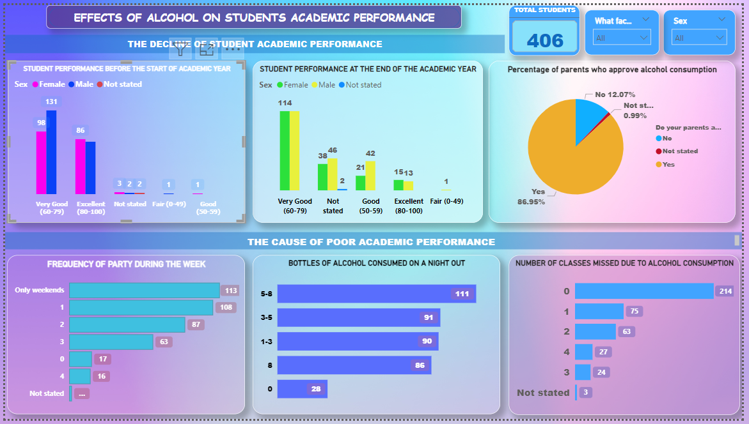
Visualisation

Slide 11
Limitations
The accuracy of the data may be affected by the reliance on self-reported alcohol consumption.
Other factors such as socioeconomic status, mental health, and study habits could also influence academic performance, and their effects may not be fully isolated in this analysis.
There wasn’t enough academic data to give a more convincing insight on the correlation between alcohol consumption and academics.
There were some missing records in the data set.

Slide 12
Recommendations
Educational institutions should consider policies aimed at reducing alcohol consumption among students.
Implement support programs focusing on responsible drinking and its impact on academics.
Conduct more extensive studies with larger and more diverse samples to validate findings and explore additional factors.

Slide 13
Consclusion
The analysis indicates a clear negative impact of alcohol consumption on student academic performance. While the study provides valuable insights, it also highlights the need for further research and the importance of addressing alcohol consumption within educational settings. By leveraging the insights gained from this analysis, institutions can develop targeted interventions to help improve student outcomes.

Slide 14
Thank You

